Slide 1
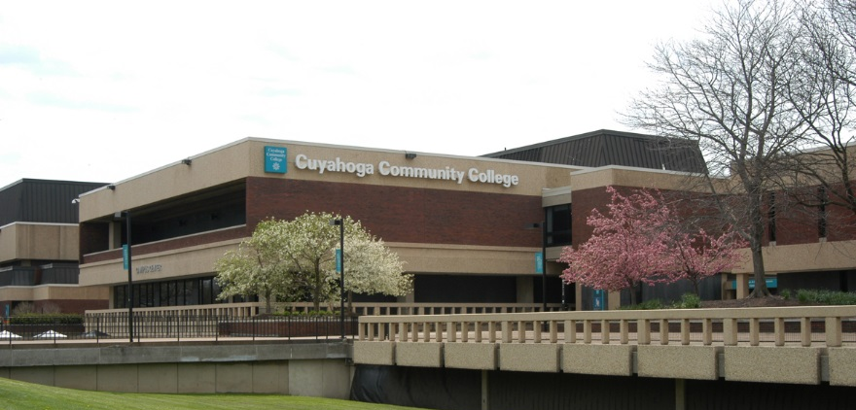
The Tenure Process at Tri-C

Slide 2
Tenure Process
Eligible after five years of service
Must have served over 50% of annual contractual time in a teaching capacity
(classroom instruction, college
librarian or counseling)

Slide 3
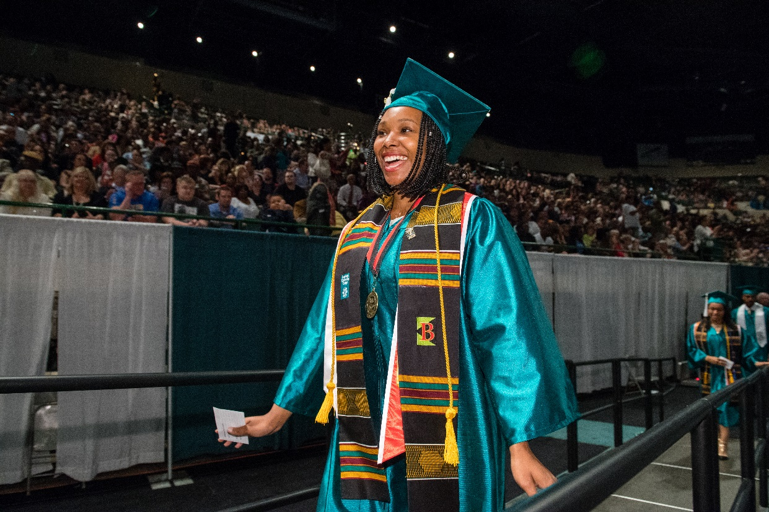
Tenure Process
To receive tenure a faculty member must demonstrate:
Teaching ability
Creative achievement
Academic integrity
Professional service to the College

Slide 4
Table of contents
Introductory Section
CV
Personal Statement
3-5 Letters of Recommendation
Tenure Criteria
Teaching Ability
Academic Integrity
Creative Achievement
Professional Service
Appendix of Additional Supporting Materials

Slide 5
Notes from the Provost
Date of Submission: January 20, 2021
Begin each section with a Summary Page explaining what is contained within that section
Provide more in the Summary and in the individual pieces of material than merely the program from a conference you attended; explain why you went; why it was important; and how you and the College benefit from your participation in the event
Include in your portfolio student evaluations including specific notes etc. sent from students. Notes or comments from students can be included in the appendix.
Include 3 or 4 examples of Professional & College involvement
If submitting a hard copy of your portfolio, place individual sheets in plastic sleeves
Provide more than one example pertaining to a specific aspect

Slide 6
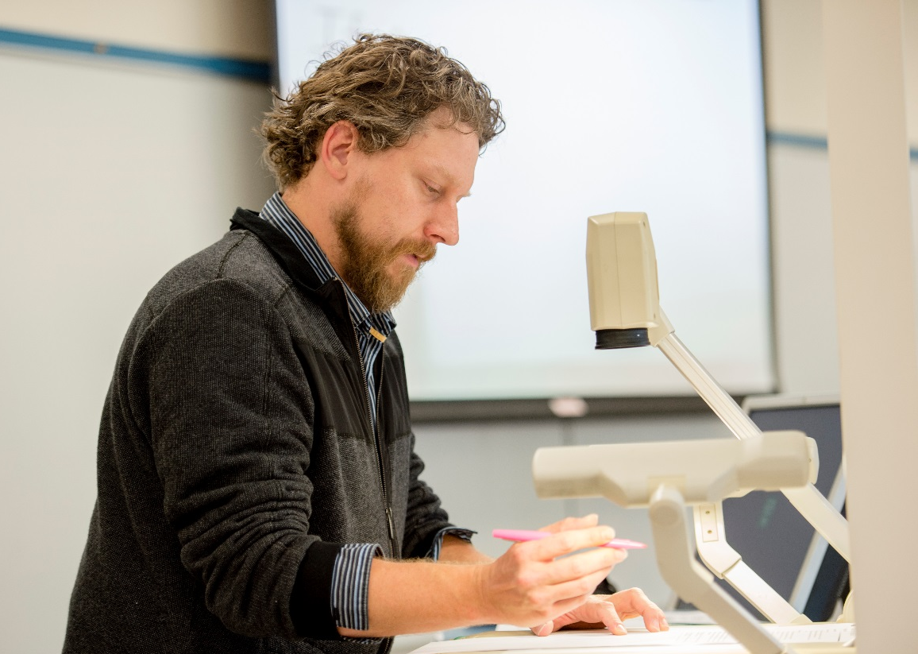
Teaching Ability
Summarizes the scope and quality of your teaching performance
Supervisor reviews, peer reviews, student evaluations
Evaluation by dean: each term for first 2 years of tenure track, then in each year for remaining 3 years of tenure track
Student evaluations happen each class, 2/3 of the way through the course
Focus on classes! Work collaboratively with assoc. dean/dean…let them guide you and your work
Can’t do everything right out of the gate
Not a rubric to check off boxes… portfolio reflects a body of work over 5 years
Assessment…what you’re doing now can be part of the portfolio…Reflect your journey!
Class Prep is your primary role! Student Success!

Slide 7
Creative Achievement
New and insightful way of doing things at the College
New and novel or refreshed way of doing things
Do not just put in things from your day to day teaching activities – remember, this is not just a teaching lesson – should be innovative
Creating presentations, updating curriculum, creating new courses, program development, curriculum revamp, new methodology, changing how we think, use of technology, solid education with demonstrations of continuous learning, national presentations, research, publication, new online delivery methods
New Creative assignments..
New/Revised Curriculum…Show us evidence that you’re continually working to improve your teaching

Slide 8
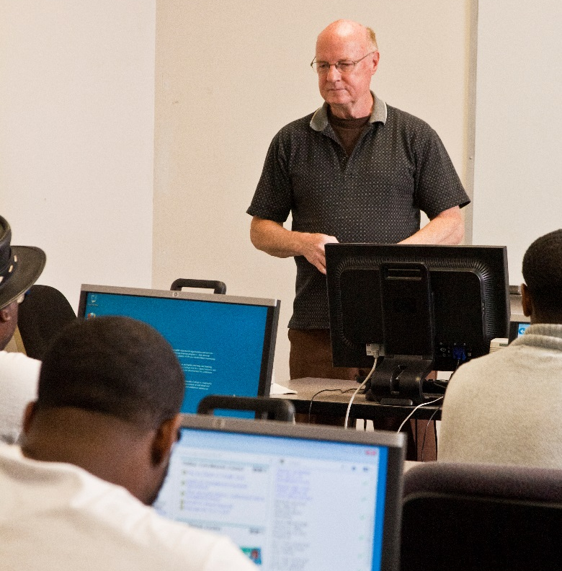
Academic Integrity
Continuing to advance knowledge in your discipline and in teaching
Show that you are qualified to teach this content – as vetted during hiring and reinforced during tenure process
Advance your knowledge in your discipline and in your teaching
Show us your new skills
Continuing education in your field, professional licenses, you continue to learn in your own discipline
Do not simply put in flyers of conferences attended – describe what you learned and how you incorporated it into your work at Tri-C – tell the story in your portfolio

Slide 9
Professional Service
Can be service to the College, its students and the community at large
To the college – easy to fulfill with service credits – lots of opportunities for you to volunteer
To its students – many ways to engage with students -- care teams, study jam sessions, student convocation, FYE, open houses, GradFest, success week
To the community – can be much more personal but must still represent Tri-C; there are so many organizations in this community so please let us know about your involvement
Find your passion and follow it! Do what you love.

Slide 10
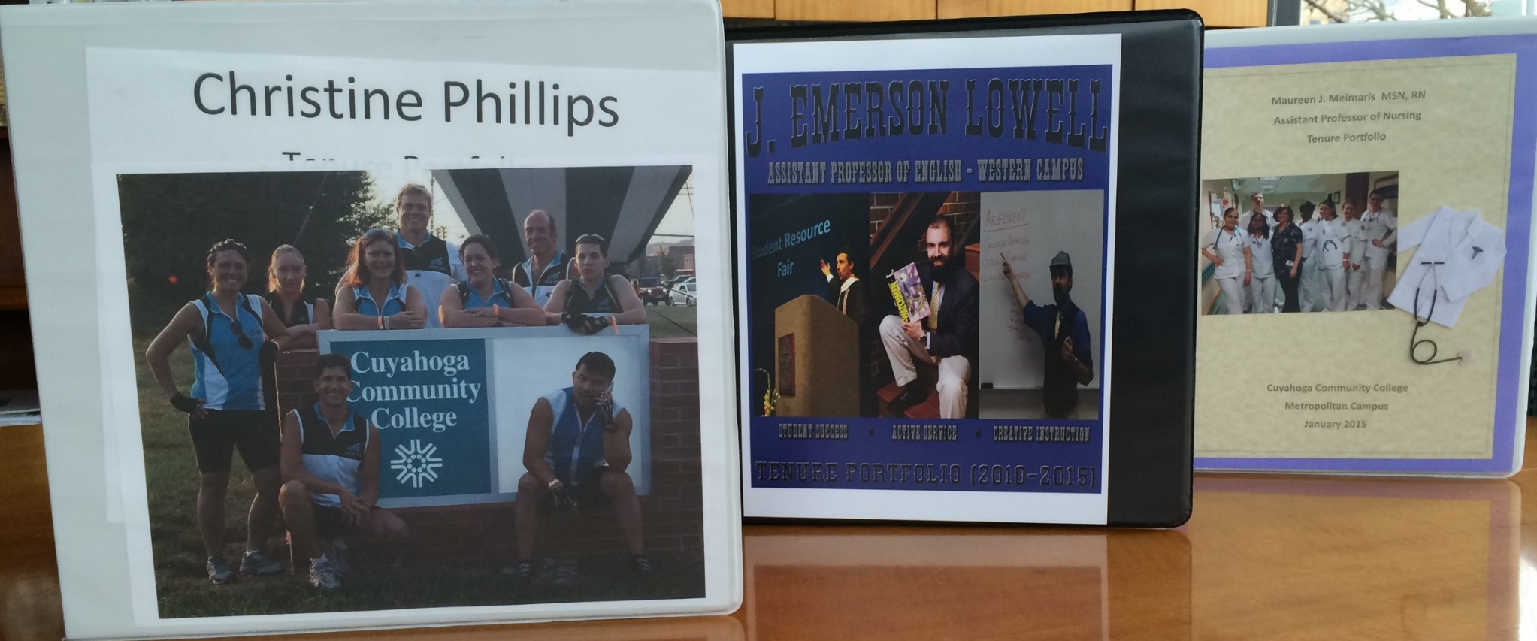
Tenure Applications – Then…

Slide 11
E-Tenure: The Tenure Process Goes Digital!

Slide 12
The Old Process
Paper collection of materials (including attendance)
Digitization for personal convenience
Submission / amassing of books
Variation in binder styles
Difficult review process (collegial & individual)
Book logistics and security

Slide 13
The New Process E-Portfolio
Mirrors current paper process
Easy digital file upload (over 200 file formats)
Well organized sections (with multiple views)
Cloud storage and 24/7 availability
Mentor review before submission

Slide 14
The New Process Workflow
E-Submission (frozen in time)
Work flow approval process
E-notification of decision
Use of E-Tenure Portfolio for other faculty processes

